Slide 1
Hotel analysis
By Parkhat Bazakov
Last updated: 3/10/23

Slide 2
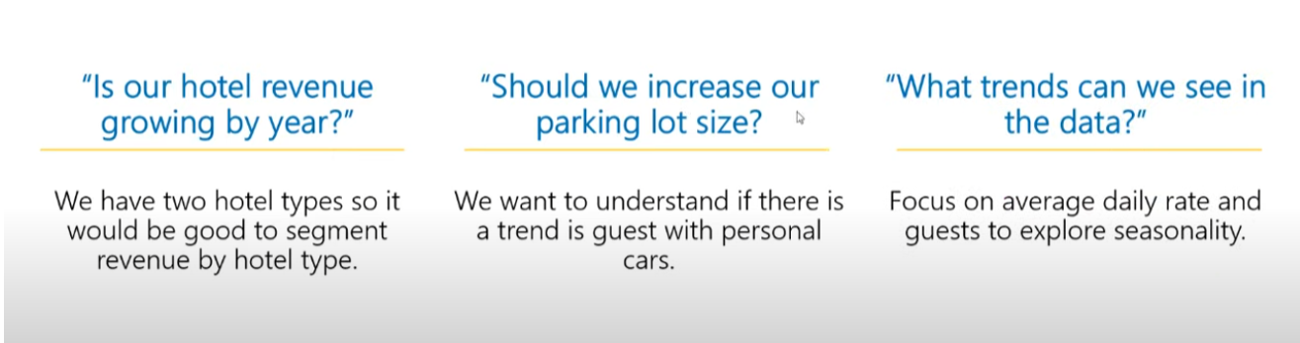
Questions

Slide 3
Data scource
Secondary data
https://absentdata.com/data-analysis/where-to-find-data/

Slide 4
Preparatory steps taken before analysis
Retrieved, Cleaned and Transformed data using SQL:
Joined tables to have an overview for 2018, 2019, 2020 year
Cleaned the data removing duplicates, and null values
Visualised data using Power BI and prepared interactive Dashboard

Slide 5
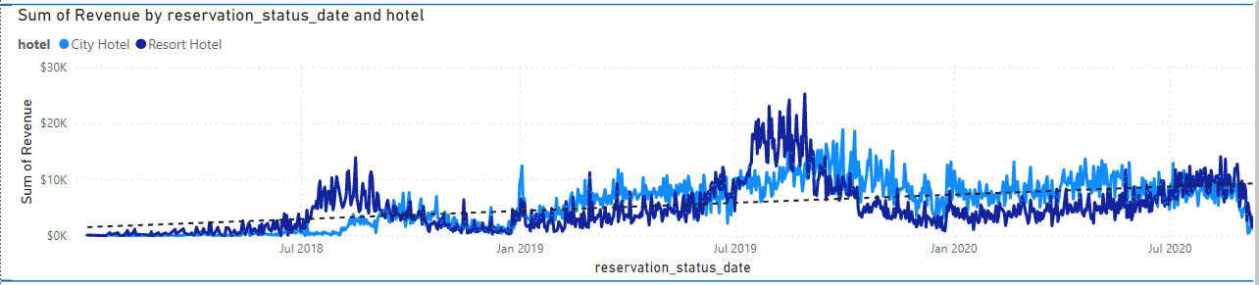
Is hotel revenue growing by year?
The analysis shown a growth in revenue from 2018 to 2019 by 437 %, yet it showed the decline of 139 %
In general, there is a positive growth in revenue.
Global pandemic could be one of the reason of the revenue decline in 2020.

Slide 6
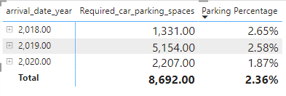
Should the size of parking lots be increased?
Demand for parking is averaging at 2.36 % of the total customers, and does not shows growth.
Size of parking lots does not needs to be increased.

Slide 7
Trends shown in the data
Years 2018 and 2019 have shown a trend where majority of the customers arrive in the third and fourth quartiles of the year .
For Resort hotels 3rd quartile is the most profitable.
Fro the City hotels 4rth quartile is the most profitable.
Year 2020 did not show such trend, most probably due to the global pandemic.

Slide 8
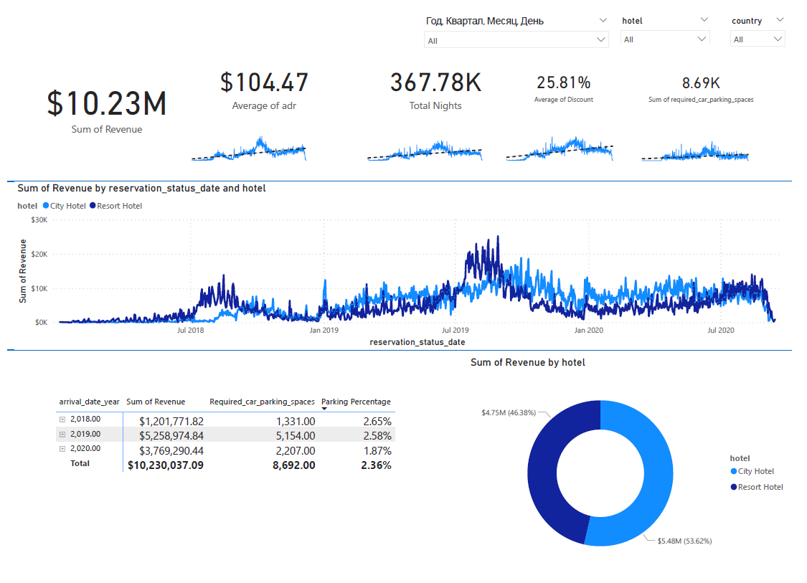
Overview of the
Interactive Dashboard

Slide 9
Conclusion
Data has shown overall upwards trend before the year 2020, matter requires more exploration in the post-pandemic environment.
If the parking lot increase is required, it could be treated on the seasonal basis e. g. renting extra- parking spaces during certain seasons.

